Slide 1

TrashCan - Application to segregate Waste using Deep Learning
SRM INSTITUTE OF SCIENCE AND TECHNOLOGY
SCHOOL OF COMPUTING
DEPARTMENT OF COMPUTING TECHNOLOGIES
18CSP109L - MAJOR PROJECT
Supervisor name: Dr. S. Babu
Designation: Associate Professor Department: Department Of Computing Technologies
Batch ID: B145
Student 1 Reg. No: RA1911003010090
Student 1 Name: Naman Jain
Student 2 Reg. No: RA1911003010108
Student 2 Name: Suvodeep Saibal Sinha

Slide 2
Project Abstract
In 2022, India ranks last among the 180 participating countries in the environmental performance index. This is due to poor handling of waste management and pollution. With the emergence of several government schemes such as “Swachh Bharat Abhiyan” and “Smart Cities Mission”, there has been a surge in both garbage production and its collection. But, there is zero effort to segregate the waste.
A major part of segregation is still dependent on manual labor which is slow and inefficient. Hence, we propose an automated way to segregate waste into recyclable and non-recyclable components using Deep Learning(Convolutional Neural Networks) embedded into a Mobile Application.

Slide 3
Introduction
We've been working on this concept previously, and owing to our research into the automation of waste segregation, we were able to create a mobile application that successfully sorts garbage into 12 different categories.
This includes paper, cardboard, biological, metal, plastic, green, brown glass, white glass, trash, clothes, shoes, and batteries . It relies on live image capture and currently generates one class of output.
Now, we plan to use other image classification techniques using the same dataset of 15000+ images consisting of different types of waste to generate multi-class output and also we are finding solutions that will update the database recursively.
The system is also tested on real images taken by the user within the intended usage environment through our mobile application.

Slide 4
Motivation
Segregation and management of waste have been a longstanding issue that has impacted a vast percentage of the ecosystem. It is easier to manage waste using today’s technology if they are applied properly.
We found that most available datasets classify garbage into a few classes (2 to 6 classes at most). Despite that, among all the previously explored options, the highest accuracy achieved was 79.94% with CNN and (SVM as last layer) using partial data augmentation. However, no matter what techniques which were added on, it was extremely hard to break through the 80% threshold with the scratch model.

Slide 5
Literature Review
A literature review is a piece of academic writing demonstrating knowledge and understanding of the academic literature on a specific topic placed in context.
We have looked through approximately 10 research papers with topics or concepts related to our project. Focusing on different aspects of these papers was useful to help plan, develop, refine and write a comparative analysis of the whole corpus

Slide 6
Comparison of Existing Methods
Title | Approach and Algorithm | Accuracy | Notable Achievements | Remarks
A Method for Waste Segregation using CNN | Comparison between VGG 16, ResNet, AlexNet | 94.9 % (ResNet-50) | 25,077 images were used in the dataset Compilation of various techniques over the years | Segregation based on only 2 categories - Organic and Recyclable
Trash Classification Using CNN - Stanford University | CNN with last 2 layers replaced by a classifier (softmax or SVM) | 79.94 % (AlexNet with SVM as last layer) | Clear and simple implementation of only 2 methods Less computation power required | Categories are limited to 6 Sample size of dataset is only 2527

Slide 7
Title | Approach and Algorithm | Accuracy | Notable Achievements | Remarks
A deep learning approach based hardware solution to categorise garbage in environment | InceptionNet Neural Network Architecture using a Real-time embedded system | 96.2 % (Inception Net) | Implemented hardware solution consisting of Raspberry Pi, IR sensor and PI Camera | Only 6 classes are used to categorise garbage
Waste Segregation Using Deep Learning | Zero Shot Learning and Object Detection Algorithms | 83.60 % (YOLOv3) | Unique approach to task Algorithm mentioned clearly with plans of proposed system | Focus on Object Detection rather than classification Trained on COCO Dataset

Slide 8
Title | Approach and Algorithm | Accuracy | Notable Achievements | Remarks
Xception: Deep Learning with Depth Wise Separable Convolutions | Improvement on InceptionNet | —------ | Xception significantly outperforms Inception V3 on a larger image classification dataset comprising 350 million images and 17,000 classes. | The performance gains are not due to increased capacity but rather to a more efficient use of model parameters.
Intelligent Waste Classification System Using Deep Learning CNN | CNN(Alexnet) with last 2 layers replaced by a classifier | 85 % (AlexNet with SVM as last layer) | Takes care of overfitting with dropout layer | Limited to only 4 different categories Small dataset of 1989 images

Slide 9
Title | Approach and Algorithm | Accuracy | Notable Achievements | Remarks
Classification of Trash for Recyclability Status - Stanford University | SVM with SIFT features CNN with Torch7 framework | 63 % (SVM) | Use of a simpler algorithm as SVM Implemented an eleven layer CNN that is very similar to AlexNet | Small dataset of 2527 images DIfferentiated on the basis of 6 classes
Classification of TrashNet Dataset Based on Deep Learning Models | Inception Resnet V2, Xception architectures | 94 % (Inception Resnet V2) | Adam and Adadelta were used as the optimizer in neural network models | Limited samples of the Trashnet dataset

Slide 10
Challenges to Address
Garbage Recycling is a key aspect of preserving our environment. To make the recycling process possible/easier, the garbage must be sorted into groups that have similar recycling processes.
We found that most available datasets classify garbage into a few classes (2 to 6 classes at most).
Being able to classify the images into more classes is a big step towards improving the recycling process by increasing the percentage of recycled garbage.
To produce multiple-class output without sacrificing efficiency.
The system should be able to update the database on its own in a recurrent manner.

Slide 11
Objectives
Increased Efficiency: Automated systems can sort and separate waste materials more quickly and accurately than manual methods, reducing the time and labour required to process waste.
Reduction in Physical Strain: Automated systems can handle heavy and bulky materials that may be difficult for human workers to move, reducing the risk of injury and physical strain.
Improved Safety: Automated systems can reduce the need for manual handling of hazardous waste materials, such as sharp objects or toxic chemicals, improving safety for workers.
Reduced Staffing Needs: Automated systems can operate 24/7 with minimal supervision, reducing the need for a large workforce to handle waste management.

Slide 12
Review-1 Recap
The majority of datasets that are currently available classify garbage into a small number of classes (2 to 6 classes at most), but we provide 12 different classes.
Formerly, we concentrated on detecting a single object in the given input images. Now, we've simultaneously introduced multi-class categorization.
As can be observed from our Literature Survey, various articles compared how pre-existing architectures like ResNet (50/18), AlexNet, VGG16, and InceptionNet performed.
We conducted research on a few novel implementations that are both compatible with the project and untested in order to make our study stand out. They consist of EfficientNet, MobileNet, and XceptionNet.

Slide 13
Feedback and Suggestions
The dataset can be transferred to a cloud service other than Google Drive that is more organised.
Instead of using TFLite to connect the deep learning model and mobile application, deploy the model to the cloud while taking performance and latency into consideration.
If appropriate, consider using edge servers and accelerators to run the application.
Update the (automatic) Continuous AI if possible

Slide 14
Innovation
We moved our entire dataset of 15500+ images from GDrive to Google Cloud Platform (GCP).
Completely eliminated reliance on TFLite Model and introduced FastAPI on GCP for a public API that is 9x faster than existing technologies.
With each iteration of the Mobile App, we've added the capability of continuously updating our database.
We have submitted our abstract at an international conference and worked on new app scenarios (focused on Deployment)
Read about and faced the difficulties in using Avalanche AI for continual learning.

Slide 15
Future Work
Working on papers with focus on several aspects of model comparison and pipeline for deployment
Work on minor advancements for better user experience in App like Text to speech
Continual learning if possible to automate the entire pipeline

Slide 16
Scope and Application
The main result will be a healthy lifestyle for mankind owing to a clean environment.
It will be feasible to recover resources from segregated garbage, making it a financially sound alternative.
Prior to being sent to major landfills or processing facilities, the total amount of waste that is dumped will be reduced.

Slide 17
Architecture Diagram

Slide 18
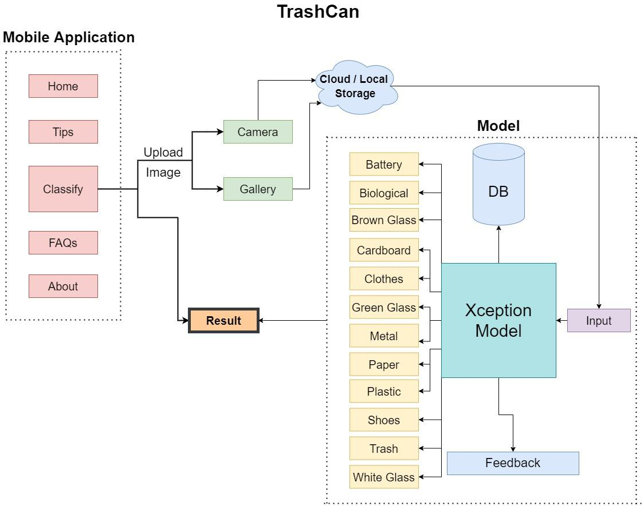

Slide 19
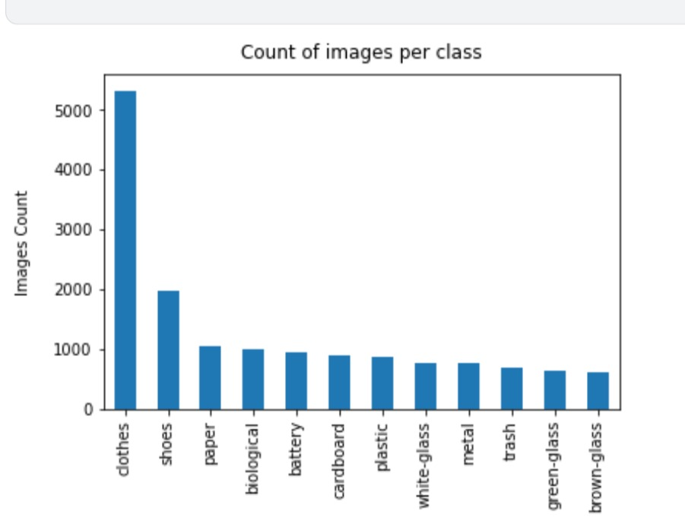
Intermediate Results
and Discussion
Category Distribution

Slide 20
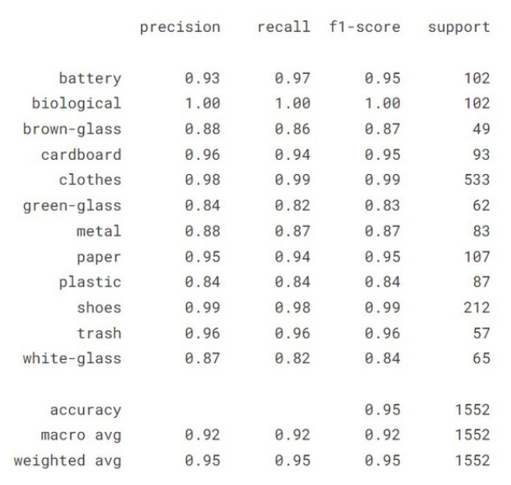
Accuracy Analysis

Slide 21
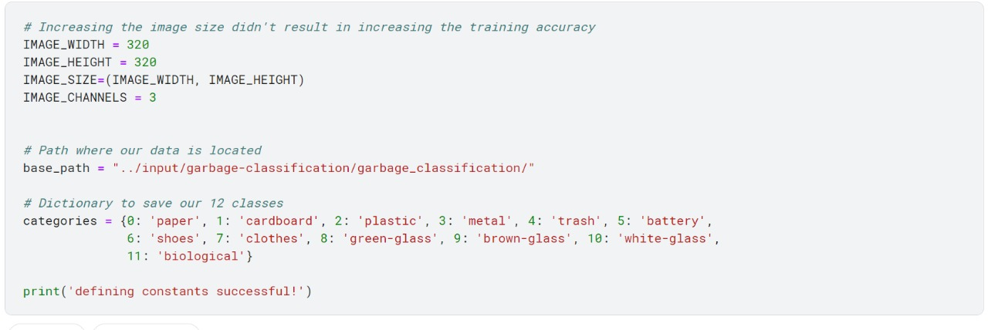
Module Description and Implementation
Defining Categories and Parameters

Slide 22
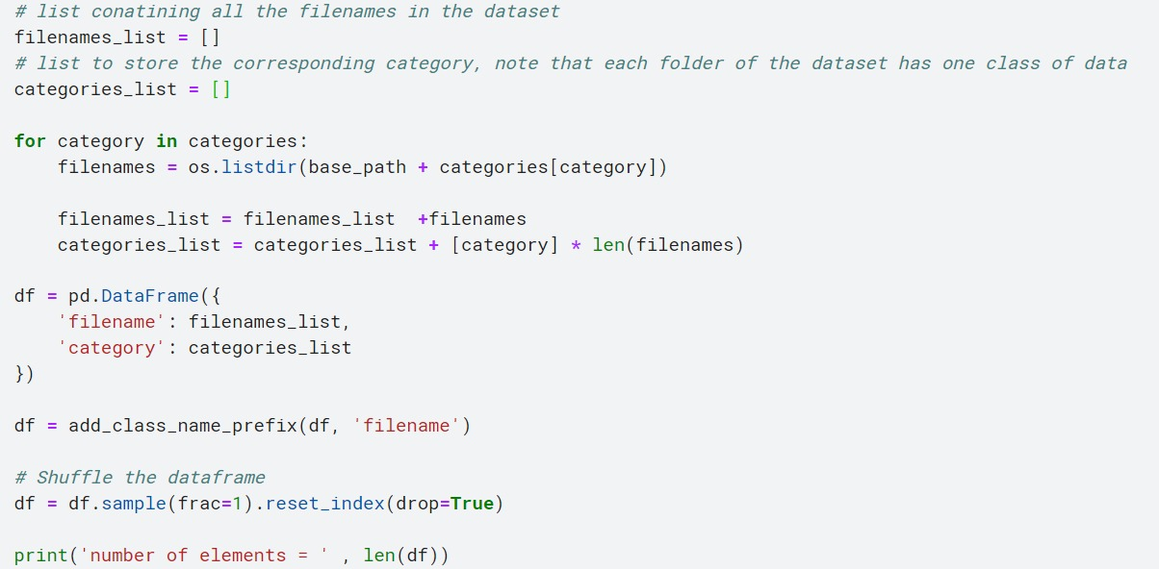
Cleaning Data

Slide 23
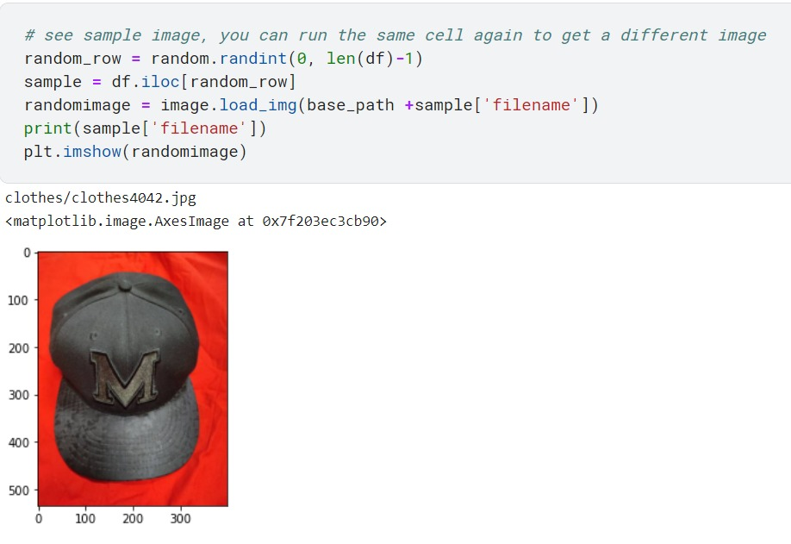
Visualizing Data

Slide 24
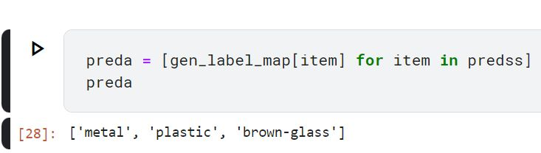
Multi Class Output

Slide 25
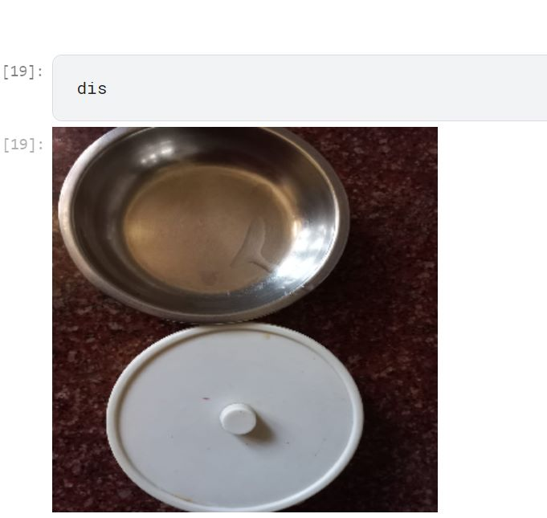
Multi Class Input

Slide 26
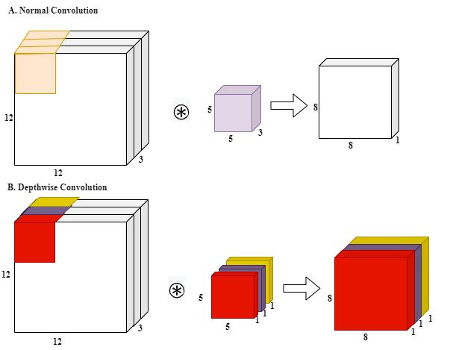

Slide 27
Flow Diagram

Slide 28
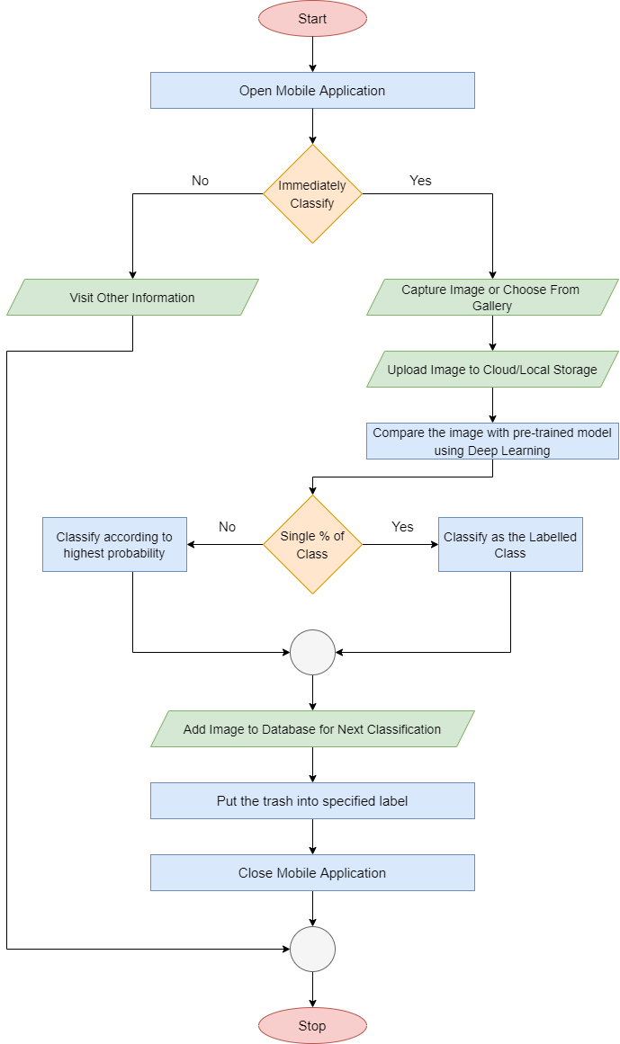

Slide 29
Screenshots

Slide 30
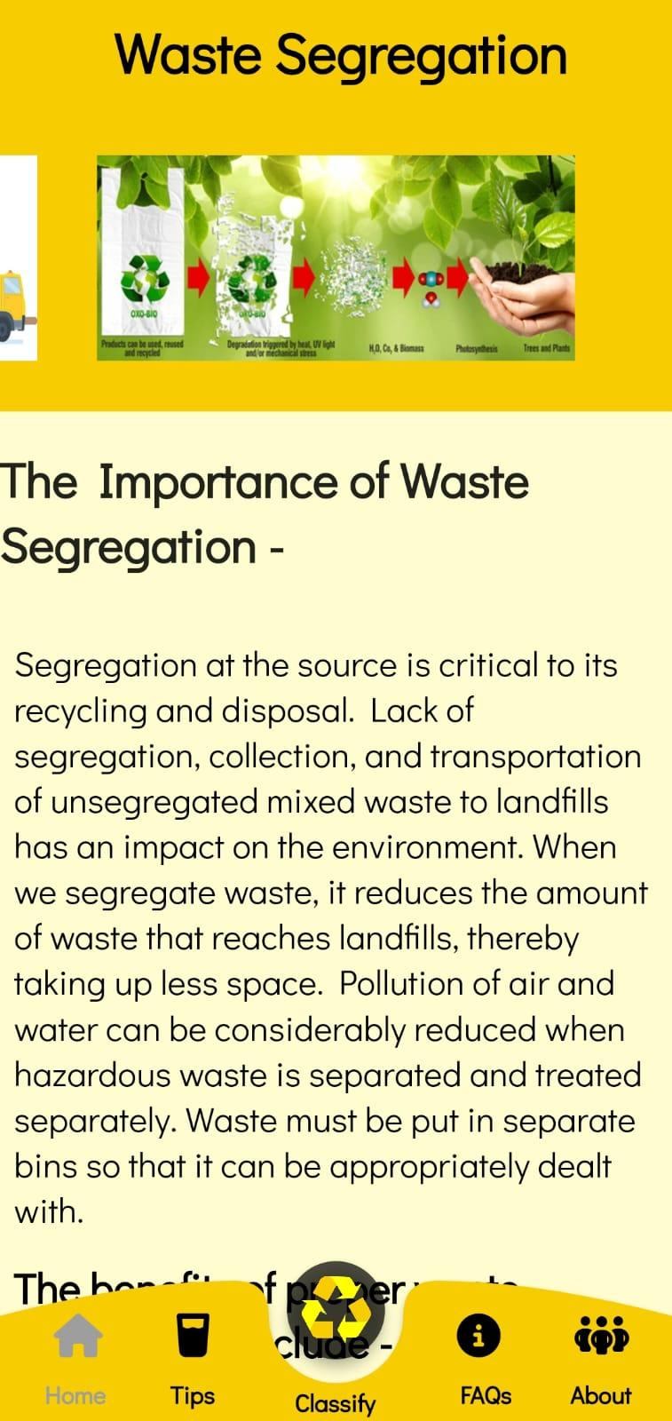
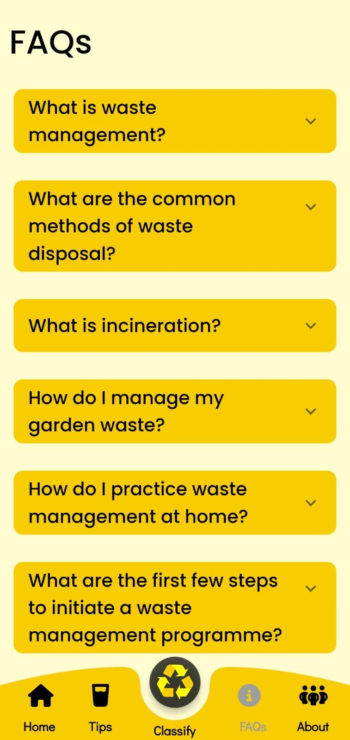

Slide 31
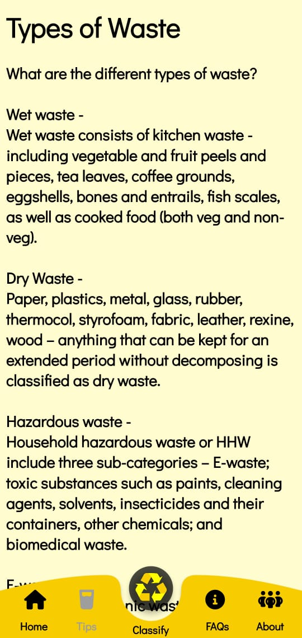
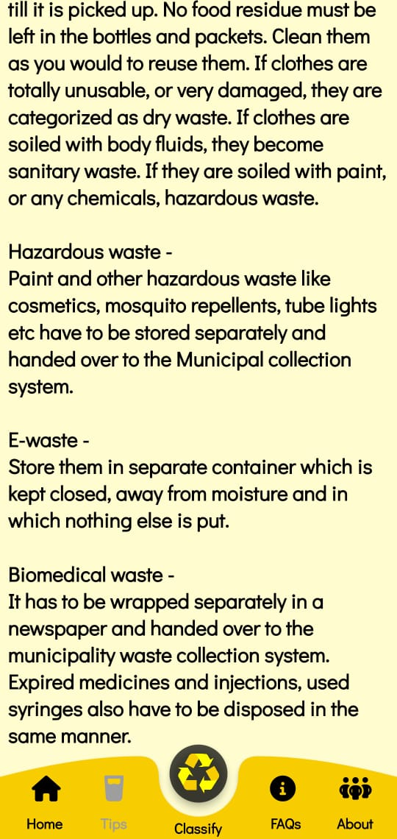

Slide 32
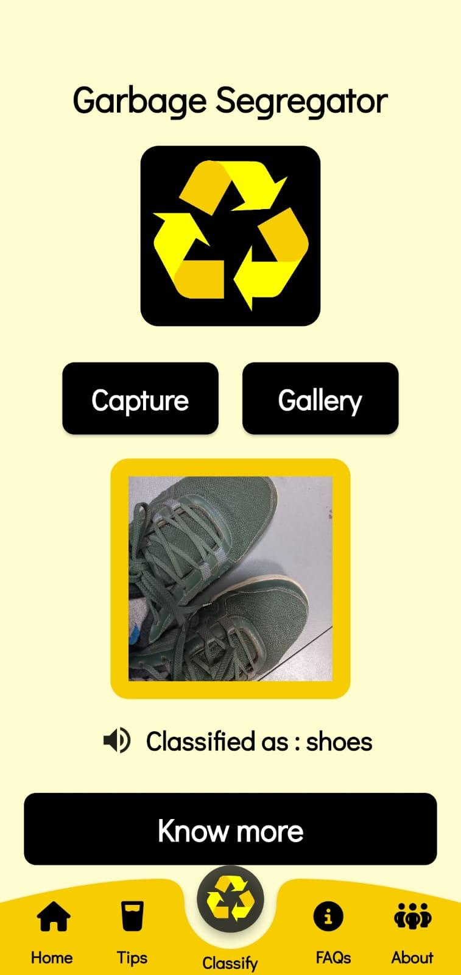
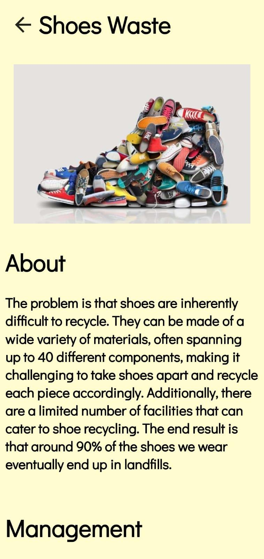

Slide 33
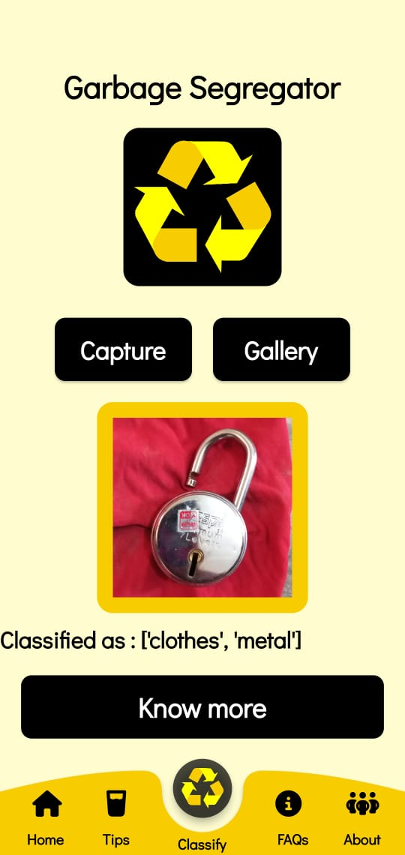

Slide 34
References
F. Chollet. Keras. https://github.com/fchollet/keras, 2015. [3] D.-A. Clevert, T. Unterthiner, and S. Hochreiter. Fast and accurate deep network learning by exponential linear units (elus). arXiv preprint arXiv:1511.07289, 2015.
https://link.springer.com/content/pdf/10.1007/s40747-021-00529-0.pdf
. Chu Y, Huang C, Xie X, Tan B, Kamal S, Xiong X (2018) Multilayer hybrid deep-learning method for waste classification and recycling. Comput Intell Neurosci
Github | “Trashnet waste repository”. https://github.com/ garythung/trashnet.
Sekar S. Waste classification data. Kaggle, 16 June 2019, www. kaggle.com/techsash/waste-classification-data.
Serezhkin A. Drinking waste classification. Kaggle, 10 May, 2020, www.kaggle.com/arkadiyhacks/drinking-waste-classification

Slide 35
ANY QUESTIONS

Slide 36
THANK YOU

